Slide 1
Data Science with Python CS 498 (Special Topics in Computer Science) Machine Learning
Dr. Malak Abdullah
Computer Science Department
Jordan University of Science and Technology

Slide 2
What is Learning?
“Learning denotes changes in a system that ... enable a system to do the same task … more efficiently the next time.” - Herbert Simon
“Learning is constructing or modifying representations of what is being experienced.” - Ryszard Michalski
“Learning is making useful changes in our minds.” - Marvin Minsky
“Machine learning refers to a system capable of the autonomous acquisition and integration of knowledge.”

Slide 3
What is Machine learning
Machine learning technology teaches computers how to perform tasks by learning from data instead of being explicitly programmed.
The process of teaching a computer system how to make accurate predictions when fed data.
Those predictions could be
answering whether a piece of fruit in a photo is a banana or an apple
spotting people crossing the road in front of a self-driving car
whether the use of the word book in a sentence relates to a paperback or a hotel reservation
whether an email is spam
recognizing speech accurately enough to generate captions for a YouTube video.
The key difference from traditional computer software is that a human developer hasn't written code that instructs the system how to tell the difference between the banana and the apple.

Slide 4
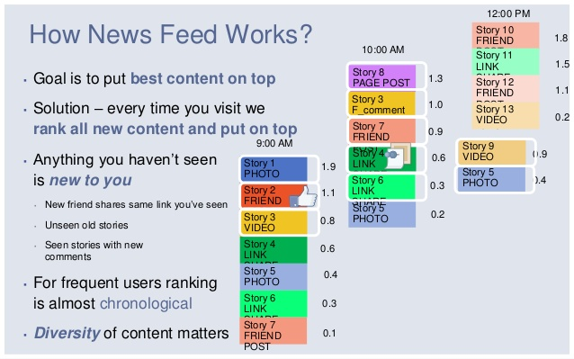
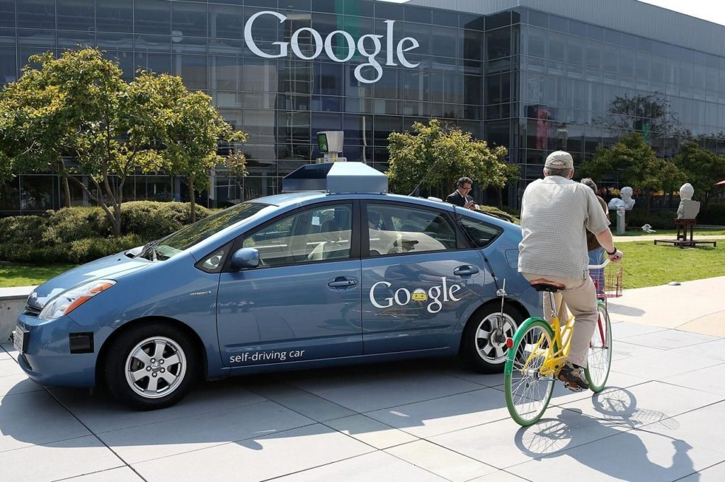
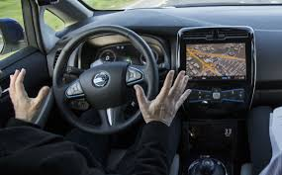

Facebook
The News Feed uses machine learning to personalize each member's feed.
If a member frequently stops scrolling to read a particular friend's posts, the News Feed will start to show more of that friend's activity earlier in the feed.
Google

Slide 5

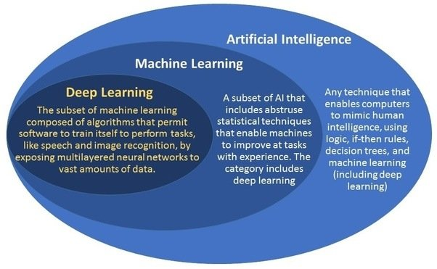

WHAT IS THE DIFFERENCE BETWEEN AI AND ML?
ML is just one method for achieving artificial intelligence.
While artificial intelligence (AI) is the broad science of mimicking human abilities, machine learning is a specific subset of AI that trains a machine how to learn.

Slide 6

ML Workflow

Slide 7
Machine learning algorithms are often categorized as supervised or unsupervised:
Supervised machine learning algorithms can apply what has been learned in the past to new data using labeled examples to predict future events.
unsupervised machine learning algorithms are used when the information used to train is neither classified nor labeled. Unsupervised learning studies how systems can infer a function to describe a hidden structure from unlabeled data
Semi-supervised machine learning algorithms fall somewhere in between supervised and unsupervised learning, since they use both labeled and unlabeled data for training – typically a small amount of labeled data and a large amount of unlabeled data. The systems that use this method are able to considerably improve learning accuracy.
Reinforcement machine learning algorithms is a learning method that interacts with its environment by producing actions and discovers errors or rewards. Trial and error search and delayed reward are the most relevant characteristics of reinforcement learning.

Slide 8
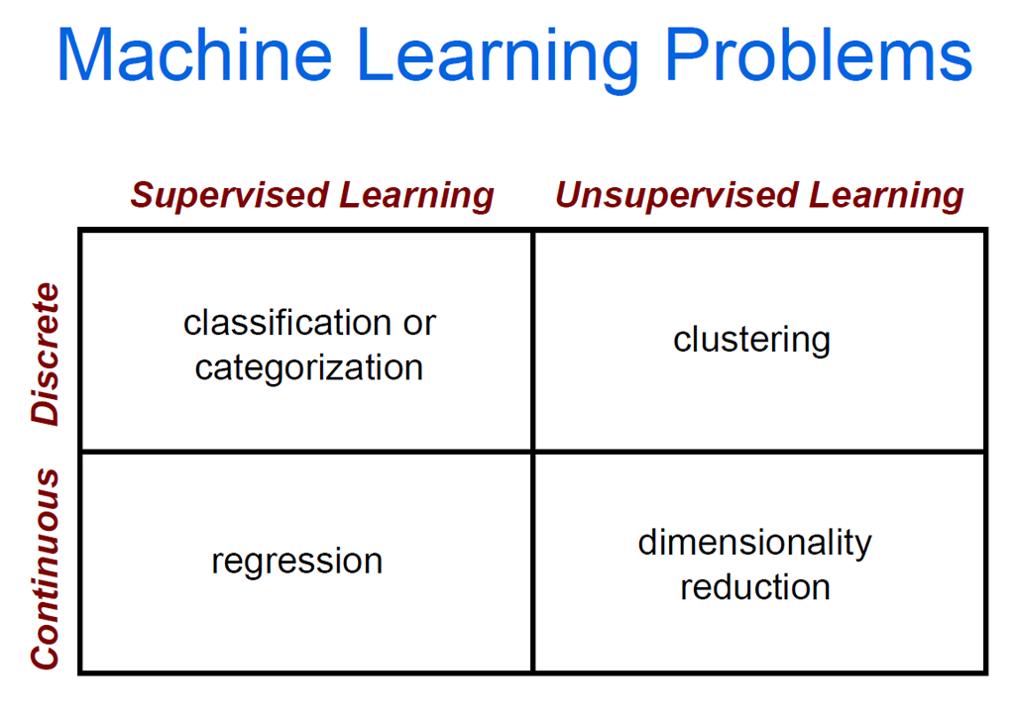

Slide 9
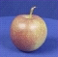
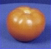
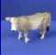
The machine learning framework
Apply a prediction function to a feature representation of the image to get the desired output:
f( ) = “apple”
f( ) = “tomato”
f( ) = “cow”

Slide 10
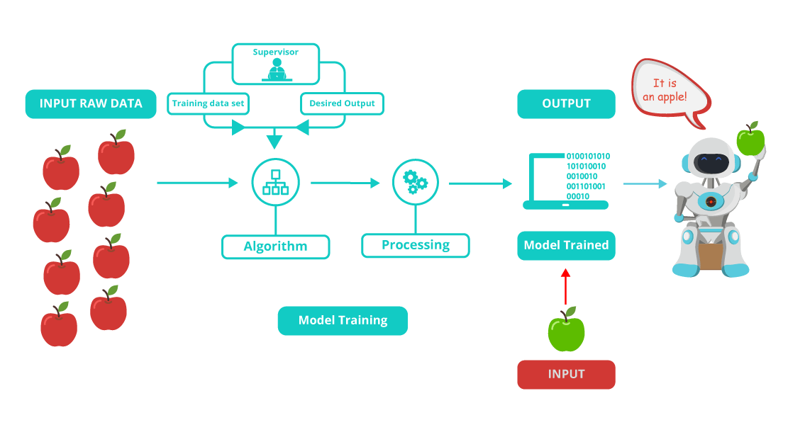
The algorithm is mainly divided into:
Training Phase
Testing phase

Slide 11
The machine learning framework
y = f(x)
output
prediction function
Image feature
Training: given a training set of labeled examples {(x₁,y₁), …, (x_{N},y_{N})}, estimate the prediction function f by minimizing the prediction error on the training set
Testing: apply f to a never before seen test example x and output the predicted value y = f(x)
Slide credit: L. Lazebnik

Slide 12

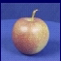
Steps
Training
Training Labels
Training Images
Image Features
Training
Learned model
Testing
Image Features
Learned model
Prediction
Test Image
Slide credit: D. Hoiem and L. Lazebnik

Slide 13
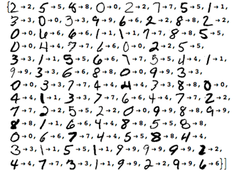
Recognizing your handwriting
Training the ML model by giving it examples of 10,000 or more handwritten digits, as well as the correct answer.
After the model is trained, we can test how well the model performs by giving it 1,000 new handwritten digits without the correct answer. The model is then required to recognize the actual digit.

Slide 14
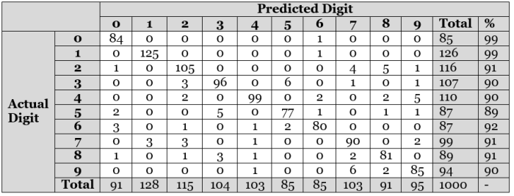
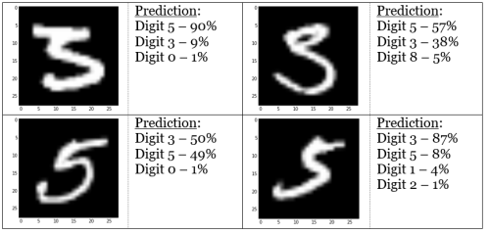

Slide 15
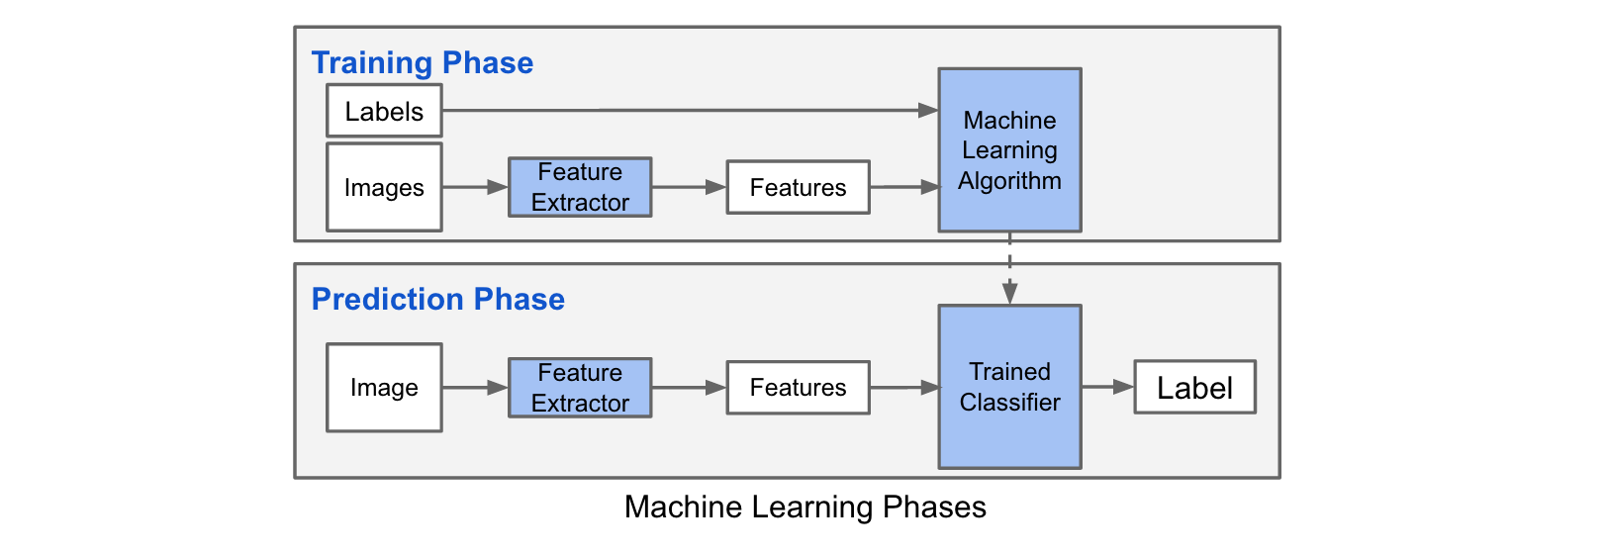
Machine learning Phases

Slide 16

Many classifiers to choose from
Which is the best one?
SVM
Neural networks
Naïve Bayes
Bayesian network
Logistic regression
Randomized Forests
Boosted Decision Trees
K-nearest neighbor
RBMs
Etc.

Slide 17
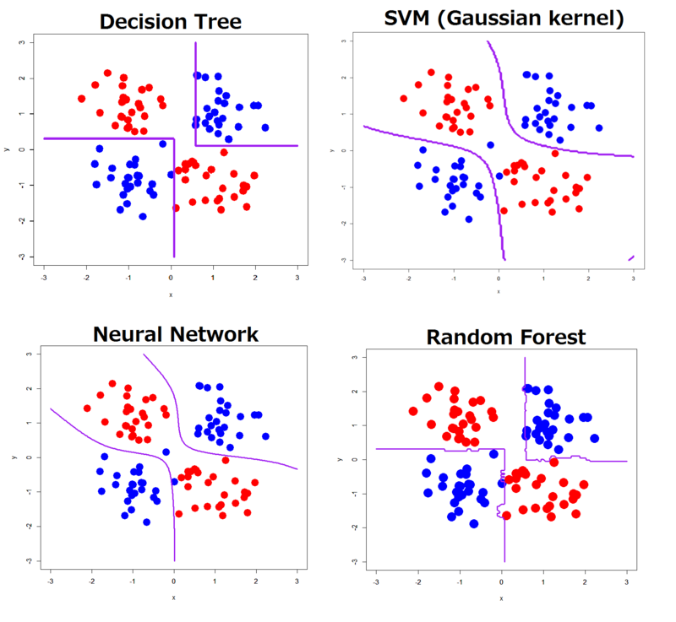
Classifiers!!

Slide 18
Classification
Assign input vector to one of two or more classes
Any decision rule divides input space into decision regions separated by decision boundaries

Slide 19
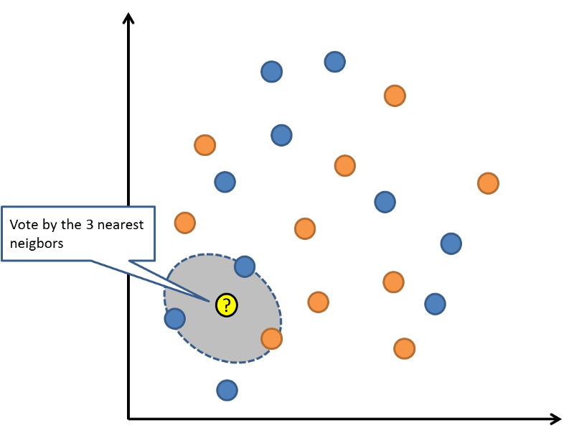
k-Nearest Neighbor (KNN)

Slide 20
K-nearest neighbor
x
x
x
o
x
x
x
+
o
o
x
x
o
o
+
o
o
x2
x1

Slide 21
1-nearest neighbor
x
x
x
o
x
x
x
+
o
o
x
x
o
o
+
o
o
x2
x1

Slide 22
3-nearest neighbor
x
x
x
o
x
x
x
+
o
o
x
x
o
o
+
o
o
x2
x1

Slide 23
5-nearest neighbor
x
x
x
o
x
x
x
+
o
o
x
x
o
o
+
o
o
x2
x1

Slide 24
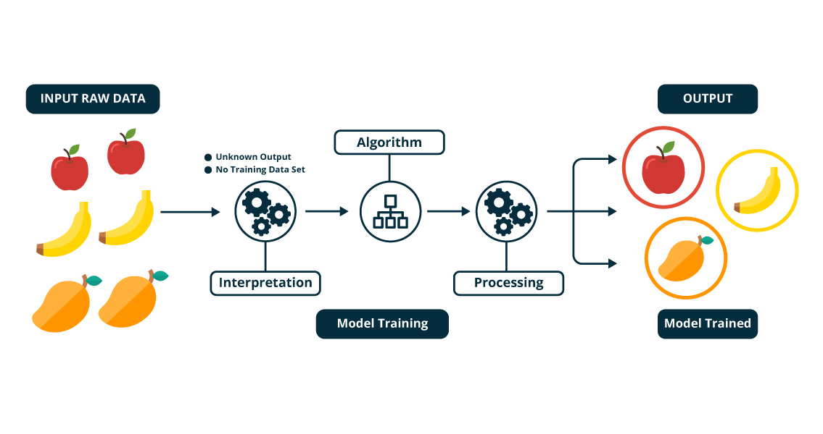
Unsupervised Learning?
Mathematically, Unsupervised learning is where you only have input data (X) and no corresponding output variables.
The goal for unsupervised learning is to model the underlying structure or distribution in the data in order to learn more about the data.

Slide 25
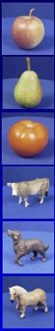
Generalization
Training set (labels known)
Test set (labels unknown)
How well does a learned model generalize from the data it was trained on to a new test set?

Slide 26
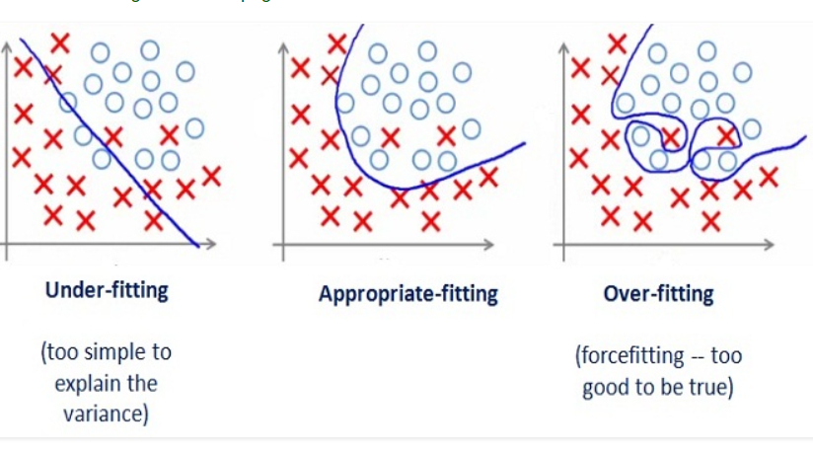
Generalization
Underfitting: model is too “simple” to represent all the relevant class characteristics
Overfitting: model is too “complex” and fits irrelevant characteristics (noise) in the data

Slide 27

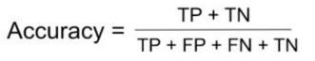
How to evaluate your model
The metrics that you choose to evaluate your machine learning model is very important.
Confusion Matrix:
Example of False Negatives (FN): A person having cancer and the model classifying his case as No-cancer
Accuracy: the number of correct predictions made by the model over all kinds predictions made
Accuracy should NEVER be used as a measure when the target variable classes in the data are a majority of one class.
Ex: In our cancer detection example with 100 people, only 5 people has cancer. Let’s say our model is very bad and predicts every case as No Cancer. In doing so, it has classified those 95 non-cancer patients correctly and 5 cancerous patients as Non-cancerous. Now even though the model is terrible at predicting cancer, The accuracy of such a bad model is also 95%.

Slide 28
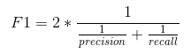
How to evaluate your model
Precision: It is the number of correct positive results divided by the number of positive results predicted by the classifier
= TP / (TP+FP)
Recall : the number of correct positive results divided by the number of all relevant samples (all samples that should have been identified as positive).
= TP / (TP+FN)
F1 score : F1 Score is the Harmonic Mean between precision and recall. The range for F1 Score is [0, 1]

Slide 29
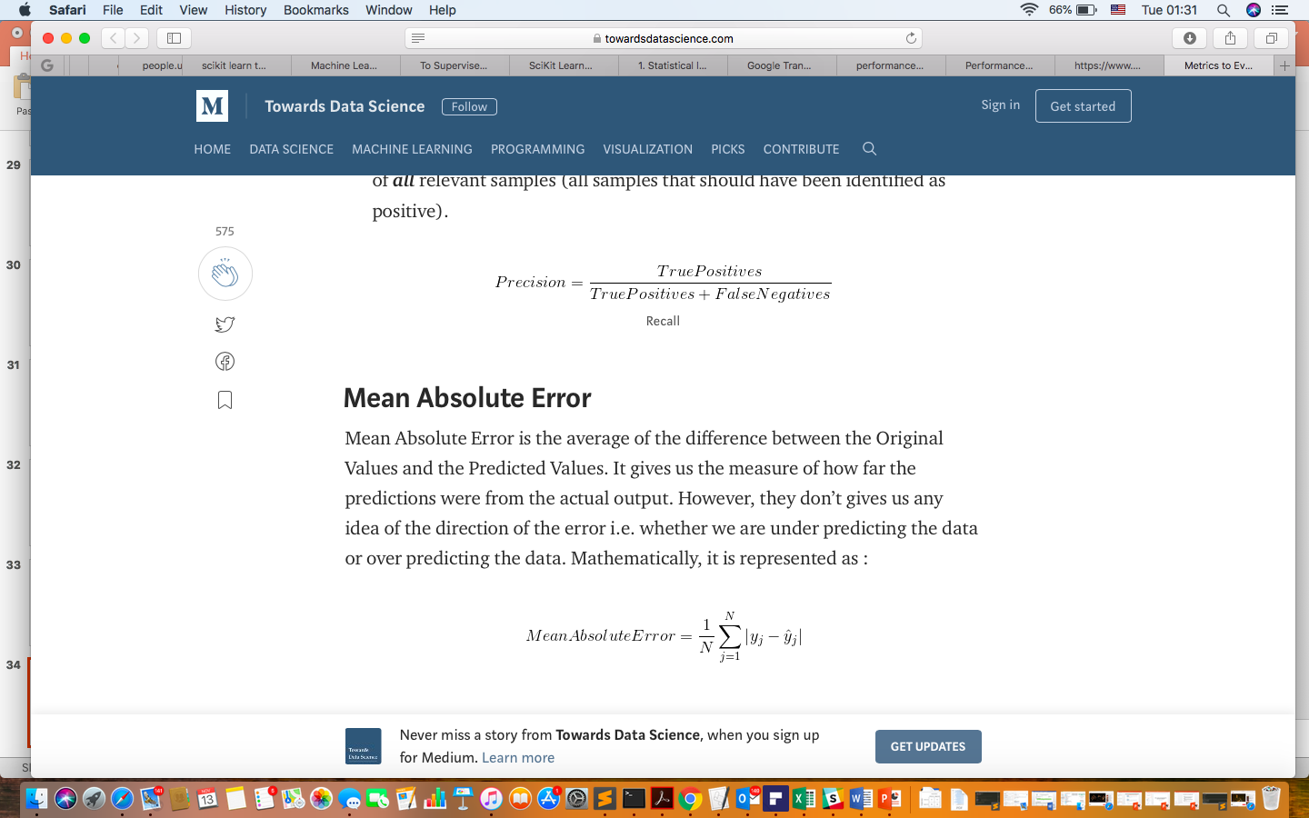
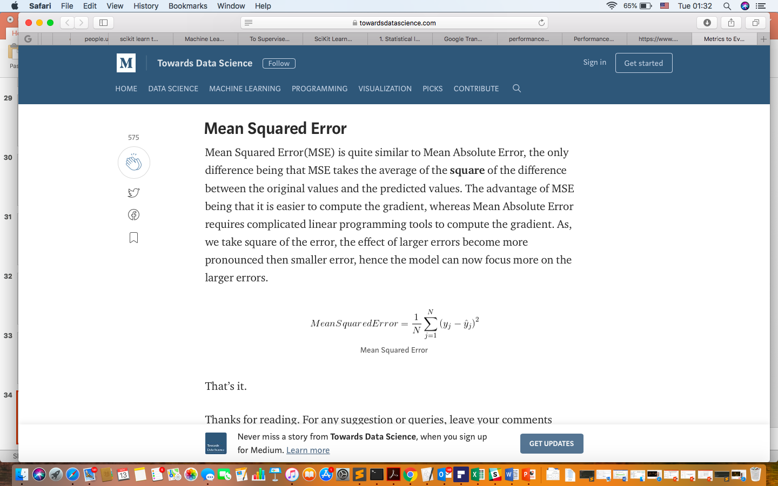
How to evaluate your model
6.
7.

Slide 30
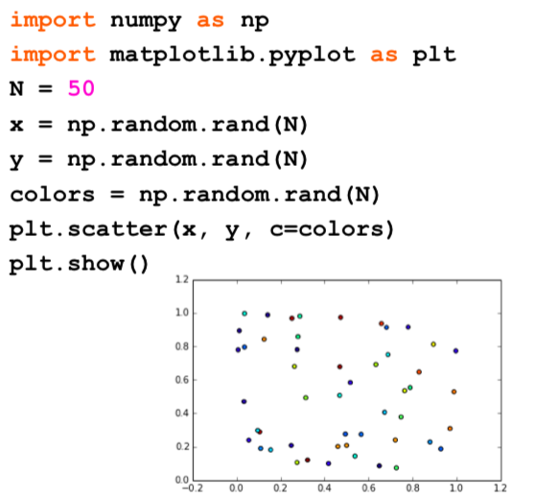
Lets start coding!!

Slide 31
Scikit-learn
Machine Learning library
Designed to inter-operate with NumPy and SciPy
Features:
Classification
Clustering
Regression
...
Website: http://scikit-learn.org/
Import
import sklearn
Fun fact: the name originates from the fact that this library is a scientific toolbox built around SciPy

Slide 32
Load your data
The first step to about anything in data science is loading in your data! ☺
To practice we can load our data from Scikit-learn
To load in the data, you import the module datasets from sklearn
The scikit-learn deals with learning information from one or more datasets that are represented as 2D arrays.
The first axis of these arrays is the samples axis, while the second is the features axis
Scikit-learn comes with a few standard datasets.
load_boston() #Load and return the boston house-prices dataset (regression)
load_iris() #Load and return the iris dataset (classification)
load_diabetes() #Load and return the diabetes dataset (regression)
load_digits([n_class]) #Load and return the digits dataset (classification)
load_linnerud() #Load and return the linnerud dataset (multivariate regression)

Slide 33
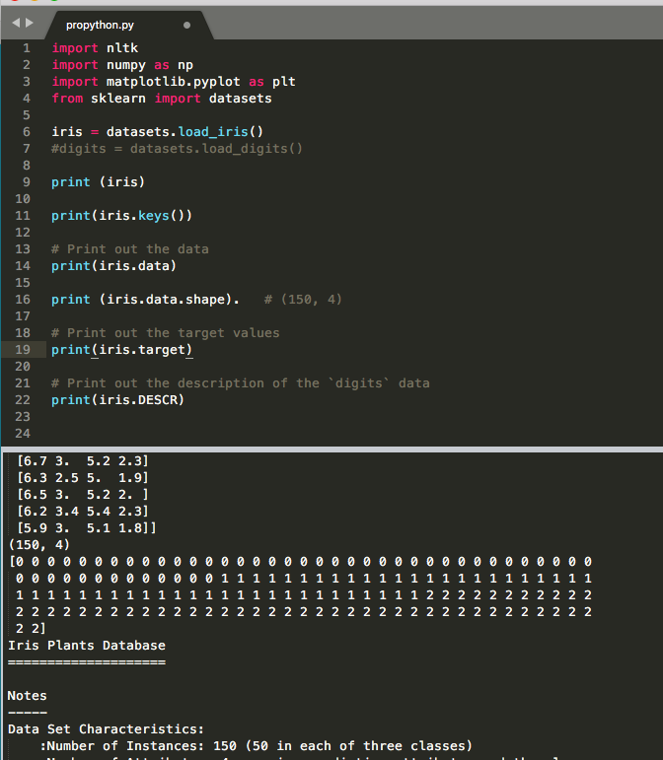
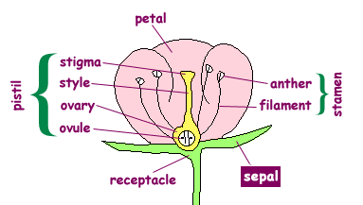

IRIS. سوسن

Slide 34
Datasets
>>> iris.data
array([[ 5.1, 3.5, 1.4, 0.2],
[ 4.9, 3. , 1.4, 0.2],
[ 4.7, 3.2, 1.3, 0.2],
…
>>> iris.feature_names
['sepal length (cm)',
'sepal width (cm)',
'petal length (cm)',
'petal width (cm)']
>>> iris.target
array([0, 0, 0, 0, 0, 0, 0, 0, ...
>>> iris.target_names
array(['setosa', 'versicolor', 'virginica'],
dtype='|S10')
A dataset object contains the following fields (n is the number of samples, m the number of features):
data: a 2D-array, with dimensions (n, m)
feature_names: a list containing the names of the features. Note: the size is m.
target: an array containing the numbers associated to the classes of samples (for supervised learning). The size is n.
target_names: an array containing the names of the classes (for supervised learning)

Slide 35
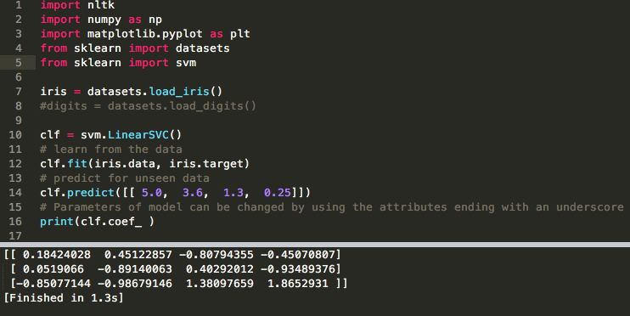
Train the model

Slide 36
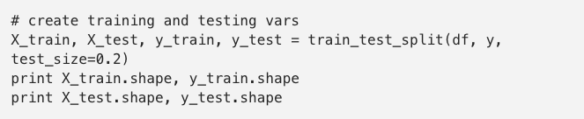
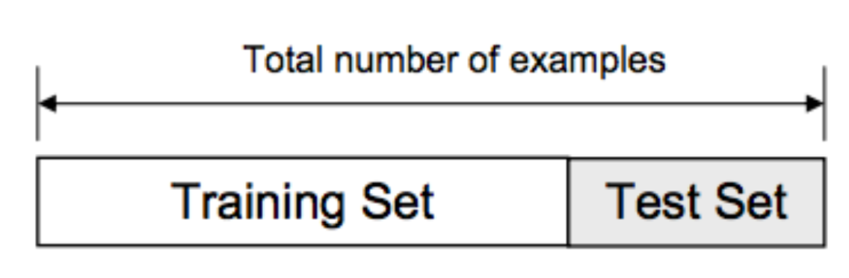
Cross validation
We usually split our data into two subsets: training data and testing data (and sometimes to three: train, validate and test), and fit our model on the train data, in order to make predictions on the test data.

Slide 37
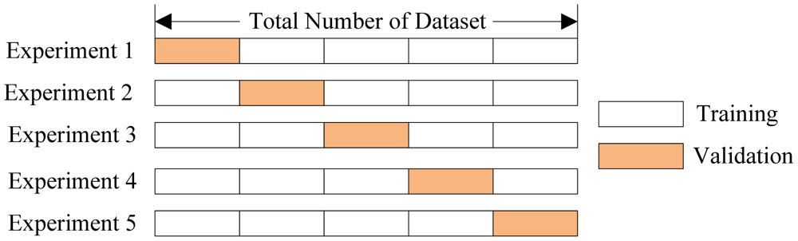
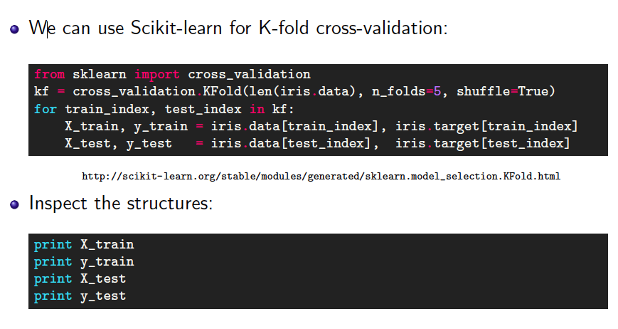
Cross Validation
Cross-validation is one of several approaches to estimating how well the model you've just learned from some training data is going to perform on future as-yet-unseen data.
We’ll talk about k-fold cross-validation,

Slide 38
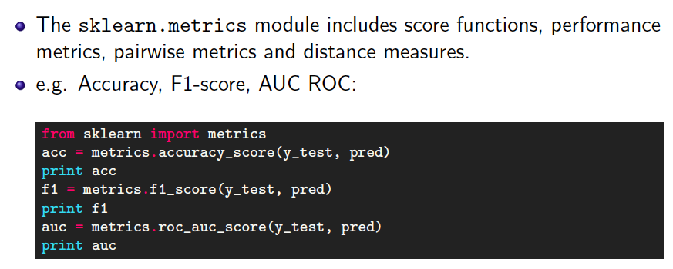
Evaluation

Slide 39
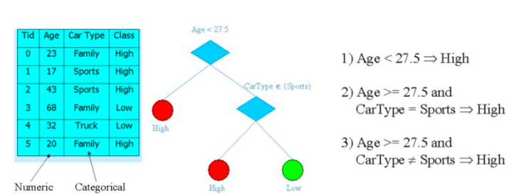
Decision tree
A decision tree is a tree where each node represents a feature(attribute), each link(branch) represents a decision(rule) and each leaf represents an outcome(categorical or continues value).

Slide 40
Decision Tree
Very simple yet powerful supervised learning methods
Utilizes an if-then rule set
The rules are learned sequentially using the training data one at a time
For each attribute in the dataset, the algorithm forms a node, where the most important attribute is placed at the root node.
Each time a rule is learned, the tuples covered by the rules are removed
This process is continued on the training set until meeting a termination condition
A decision tree can be easily over-fitted generating too many branches and may reflect anomalies due to noise or outliers.
This can be avoided by pre-pruning which halts tree construction early or post-pruning which removes branches from the fully grown tree.

Slide 41
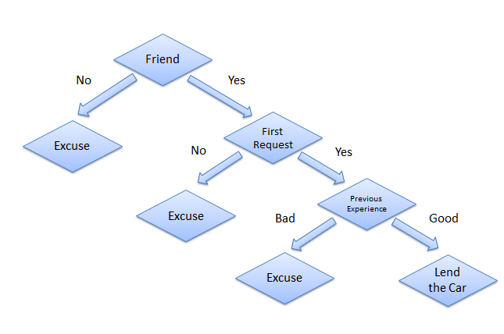
Example from the life
Consider a scenario where a person asks you to lend them your car for a day, and you have to make a decision whether or not to lend them the car. There are several factors that help determine your decision, some of which have been listed below:
Is this person a close friend or you just slightly know him? If he is not a close friend, then decline the request; if the person is a friend, then move to next step.
Is the person asking for the car for the first time? If so, lend them the car, otherwise move to next step.
Was the car damaged last time they returned the car? If yes, decline the request; if no, lend them the car.

Slide 42
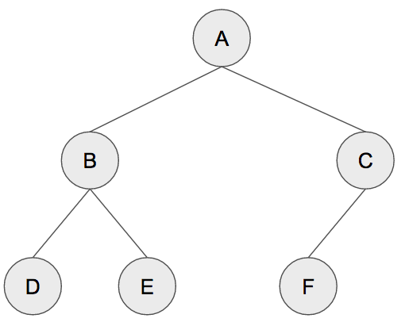
The tree
Termenology
Root = A
Depth =2
Leaf = D E F
a binary tree, each parent node must have at most 2 child nodes

Slide 43
the CART (Classification and Regression Trees)
A decision tree is a binary tree, so we need to make sure that there are no more than two splits per node.
We want to make splits so that we have many examples of only one particular class and few examples of the other.
In other words, we want the split that decreases the entropy. High entropy means that we have a mix of different classes; low entropy means that we have predominantly one class.
Ideally, we want our nodes to have no entropy, i.e., all examples at this node are definitely of one class.
Gini impurity and entropy mean the same thing: we want lower Gini impurity.
We can prune nodes, starting from the leaves. We compute the increase in entropy/impurity at the parent if we were to prune two child nodes, and perform the pruning if that entropy/impurity increase is below some constant or threshold.

Slide 44
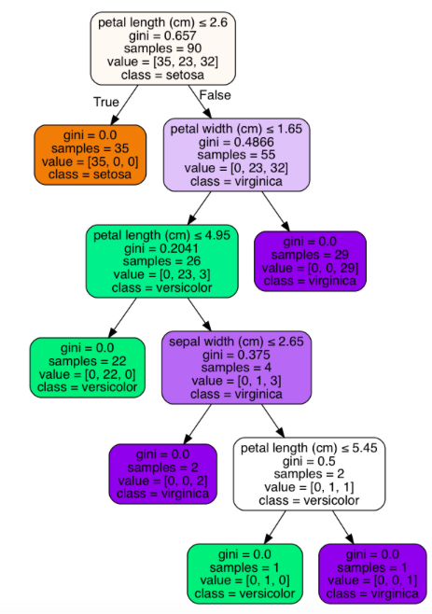
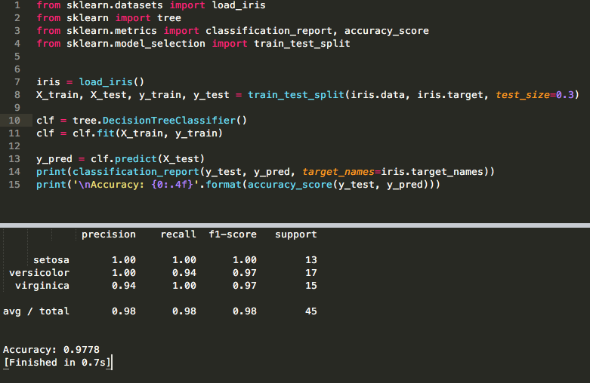
Sklearn decision tree

Slide 45
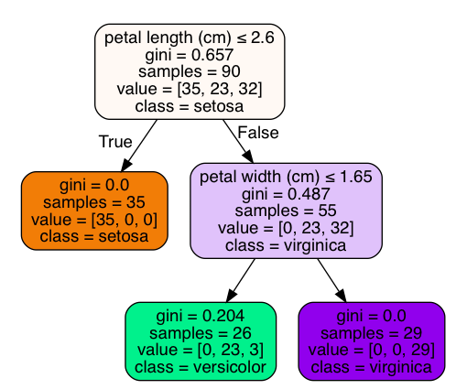
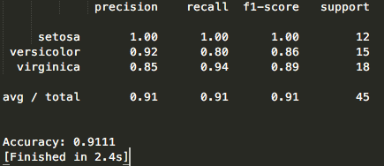
Prune
Now let’s mess with the minimum entropy threshold parameter to see if we can prune this tree and how that affects the accuracy.
Let’s set it to 0.1. This will tell our classifier that it’s okay to prune children such that the entropy/impurity at the parent after pruning is less than 0.1.
clf = tree.DecisionTreeClassifier(min_impurity_decrease=0.1)

Slide 46
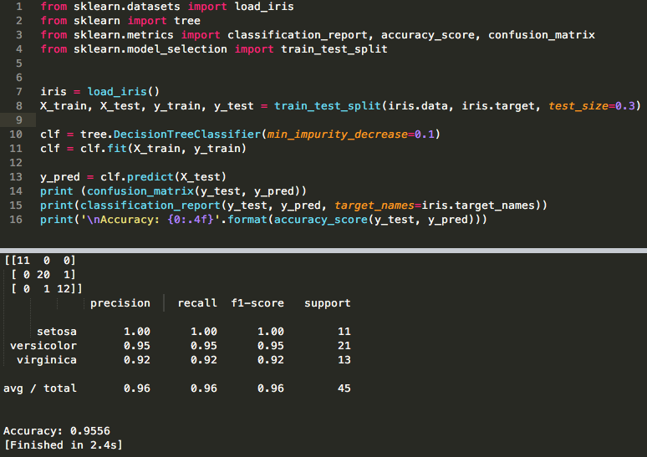
print (confusion_matrix(y_test, y_pred))

Slide 47
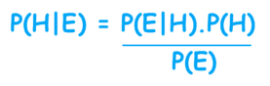
Naive Bayes
One of the most powerful algorithms for classification based on Bayes' Theorem with an assumption of independence among predictors.
The Naive Bayes classifier assumes that the presence of a feature in a class is unrelated to any other feature.
In statistics and probability theory, Bayes' theorem describes the probability of an event, based on prior knowledge of conditions that might be related to the event. It serves as a way to figure out conditional probability.

Slide 48
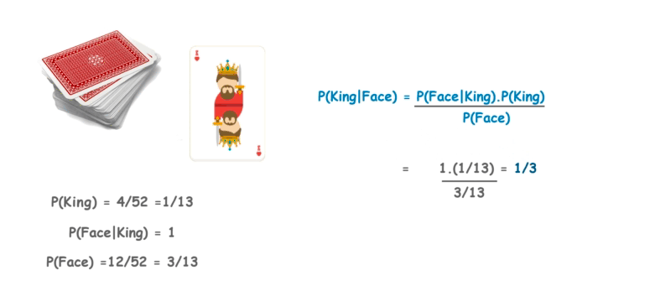
Bayes' Theorem Example
Let's suppose we have Cards and we wish to find out the probability of the card we picked at random to being a king, given that it is a face card. So, according to Bayes' Theorem, we can solve this problem. First, we need to find out the probability:
P(King) which is 4/52 as there are 4 Kings in Cards.
P(Face|King) is equal to 1 as all the Kings are face Cards.
P(Face) is equal to 12/52 as there are 3 Face Cards in a Suit of 13 cards and there are 4 Suits in total.

Slide 49
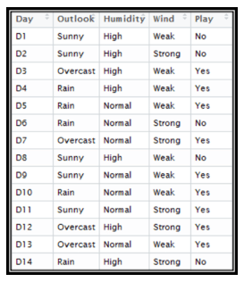
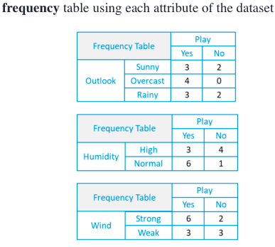
Example
Number of Yes are 9 , number of No are 5
There is a mistake here!! For sunny: 2 yes, 3 no

Slide 50
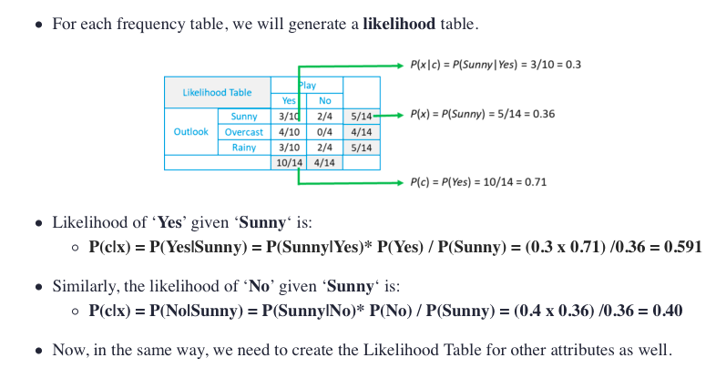
Same mistake ☹ is here too
Never mine ☺
Must be 9/14 ☺

Slide 51
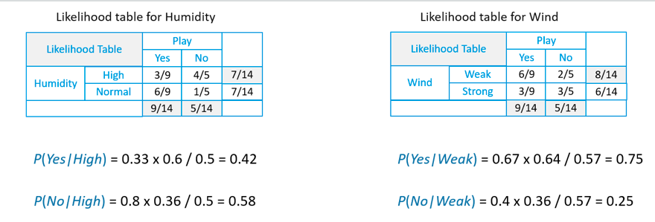
Suppose we have a Day with the following values :
Outlook = Rain
Humidity = High
Wind = Weak
Play = ?

Slide 52
predict whether we can play on that day or not.
Likelihood of 'Yes' on that Day = P(Outlook = Rain|Yes)*P(Humidity= High|Yes)* P(Wind= Weak|Yes)*P(Yes)
= 2/9 * 3/9 * 6/9 * 9/14 = 0.0199
Likelihood of 'No' on that Day = P(Outlook = Rain|No)*P(Humidity= High|No)* P(Wind= Weak|No)*P(No)
= 2/5 * 4/5 * 2/5 * 5/14 = 0.0166
Now, when we normalize the value, we get:
P(Yes) = 0.0199 / (0.0199+ 0.0166) = 0.55
P(No) = 0.0166 / (0.0199+ 0.0166) = 0.45
Our model predicts that there is a 55% chance there will be a game tomorrow.

Slide 53
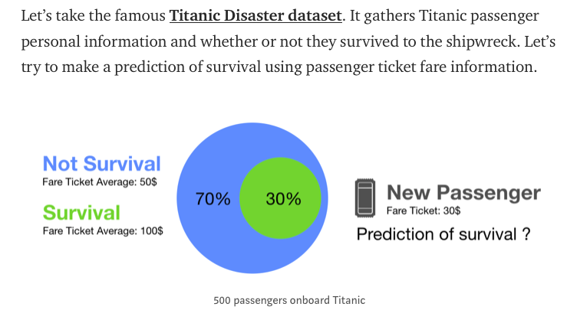
Another example
Imagine you take a random sample of 500 passengers. In this sample, 30% of people survived. Among passenger who survived, the fare ticket mean is 100$. It falls to 50$ in the subset of people who did not survive. Now, let’s say you have a new passenger. You do not know if he survived or not but you know he bought a 30$ ticket to cross the Atlantic. What is your prediction of survival for this passenger?

Slide 54
Not survive
You probably answered that this passenger did not survive. Why?
You assumed that chances of survival were low and that being poor reduced chances of survival.
You put this passenger in the closest group of likelihood (the low fare ticket group).
This is what the Naive Bayes classifier does.

Slide 55
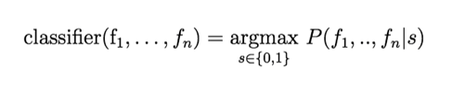
Naïve Assumption
assumption of independence among features. What does it mean?
For example, it means we have to assume that the comfort of the room on the Titanic is independent of the fare ticket.
This assumption is absolutely wrong and it is why it is called Naive. It allows to simplify the calculation, even on very large datasets.
Naïve bayse: finding functions describing the probability of belonging to a class given features.

Slide 56
There are three available models in the Sklearn python library:
Gaussian: It assumes that continuous features follow a normal distribution.
Multinomial: It is useful if your features are discrete.
Bernoulli: The binomial model is useful if your features are binary.
You can read more on: https://blog.sicara.com/naive-bayes-classifier-sklearn-python-example-tips-42d100429e44

Slide 57
Pro and cons of Naive Bayes Classifiers
Pros:
Computationally fast
Simple to implement
Works well with small datasets
Works well with high dimensions
Perform well even if the Naive Assumption is not perfectly met. In many cases, the approximation is enough to build a good classifier.
Cons:
Require to remove correlated features
If a categorical variable has a category in test data set which was not observed in training data set, then the model will assign a zero probability. It will not be able to make a prediction.

Slide 58
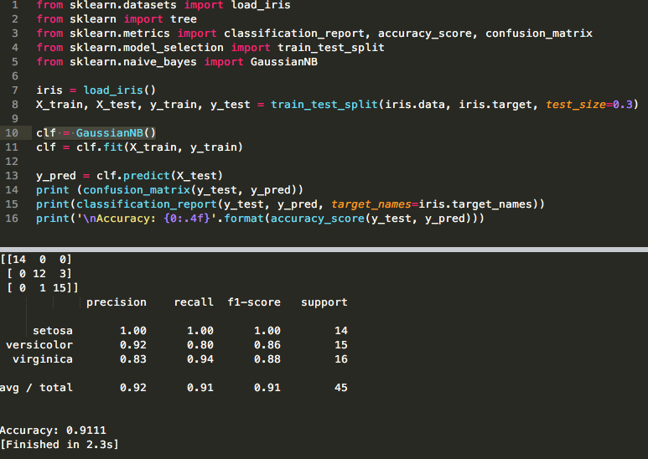

Slide 59
SVM Support Vector Machine
SVM offers very high accuracy compared to other classifiers
It is used in a variety of applications such as face detection, intrusion detection, classification of emails, news articles and web pages, classification of genes, and handwriting recognition
The classifier separates data points using a hyperplane with the largest amount of margin. That's why an SVM classifier is also known as a discriminative classifier. SVM finds an optimal hyperplane which helps in classifying new data points.

Slide 60
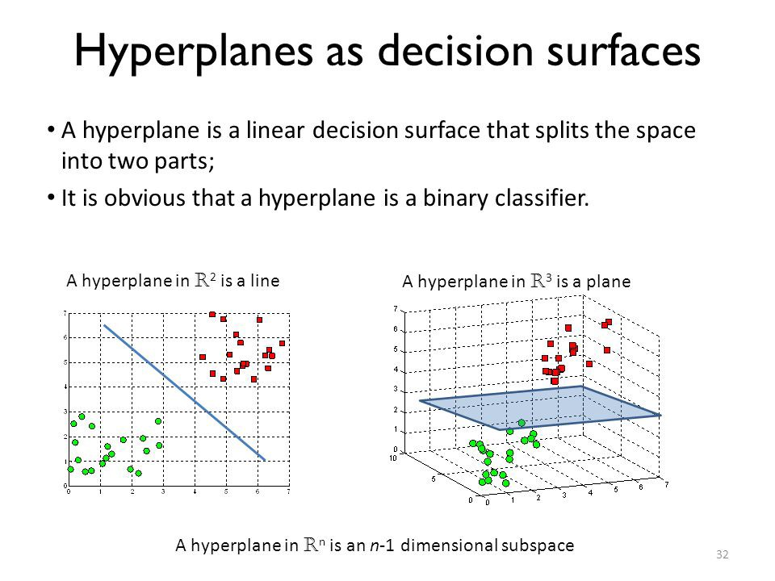

Slide 61

The core idea of SVM
SVM constructs a hyperplane in multidimensional space to separate different classes.
SVM generates optimal hyperplane in an iterative manner, which is used to minimize an error.
The core idea of SVM is to find a maximum marginal hyperplane(MMH) that best divides the dataset into classes.

Slide 62
Terminologies
Support vectors are the data points, which are closest to the hyperplane. These points will define the separating line better by calculating margins.
A hyperplane is a decision plane which separates between a set of objects having different class memberships.
A margin is a gap between the two lines on the closest class points. f the margin is larger in between the classes, then it is considered a good margin, a smaller margin is a bad margin.

Slide 63

How does SVM work?
The objective is to select a hyperplane with the maximum possible margin between support vectors in the given dataset. Follow these steps:

Slide 64

Dealing with non-linear and inseparable planes
Some problems can’t be solved using linear hyperplane:

Slide 65
SVM Kernels
The SVM algorithm is implemented in practice using a kernel.
A kernel transforms an input data space into the required form.
SVM uses a technique called the kernel trick. Here, the kernel takes a low-dimensional input space and transforms it into a higher dimensional space.
Kernel trick helps you to build a more accurate classifier.
Kernel: The main function of the kernel is to transform the given dataset input data into the required form. There are various types of functions such as linear, polynomial, and radial basis function (RBF). Polynomial and RBF are useful for non-linear hyperplane. Polynomial and RBF kernels compute the separation line in the higher dimension. In some of the applications, it is suggested to use a more complex kernel to separate the classes that are curved or nonlinear. This transformation can lead to more accurate classifiers.

Slide 66
Advantages
SVM Classifiers offer good accuracy and perform faster prediction compared to Naïve Bayes algorithm. They also use less memory because they use a subset of training points in the decision phase. SVM works well with a clear margin of separation and with high dimensional space.
Disadvantages
SVM is not suitable for large datasets because of its high training time and it also takes more time in training compared to Naïve Bayes. It works poorly with overlapping classes and is also sensitive to the type of kernel used.

Slide 67

Lets code

Slide 68

Load and Explore the data

Slide 69

Split, fit, and predict

Slide 70

Evaluating

